Slide 1


TOP 5
Most dangerous places on the Planet
Strange mysteries that remain unsolved
Natural disasters
Childhood cartoons

Slide 2
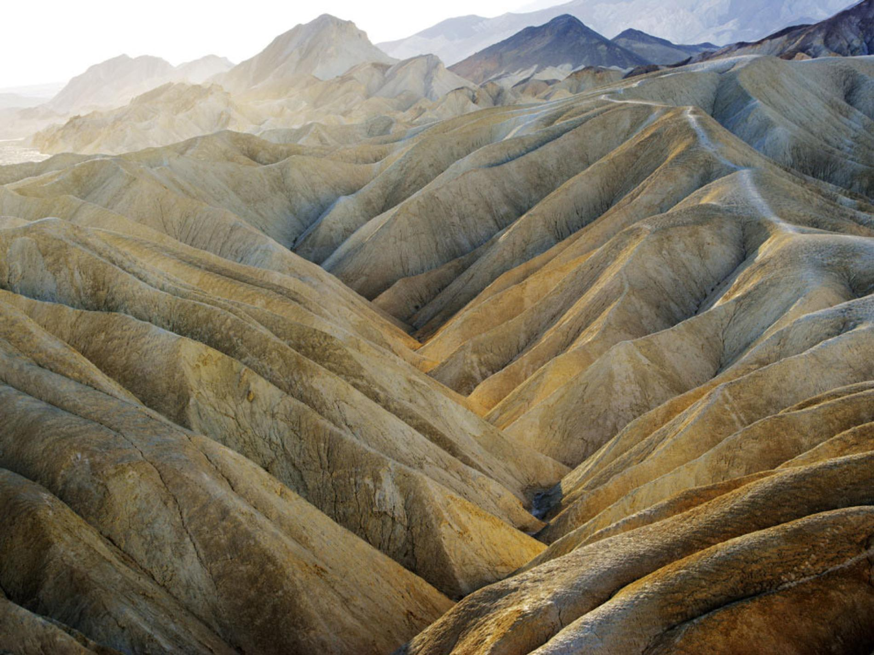
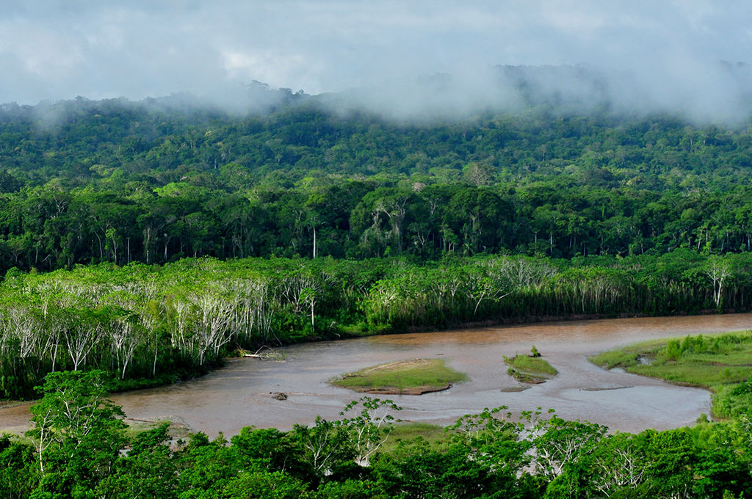
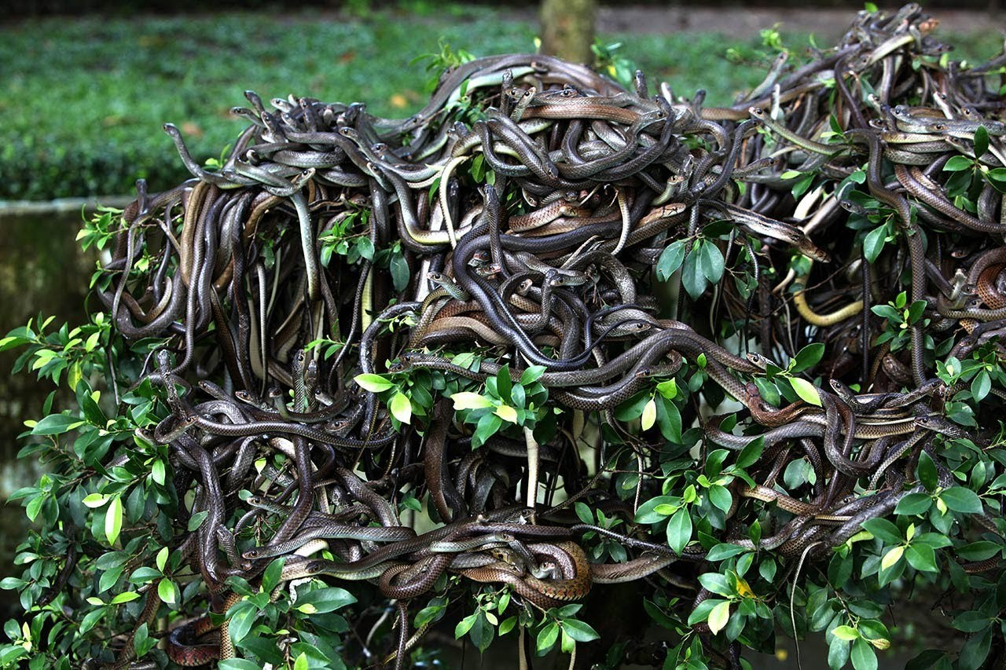
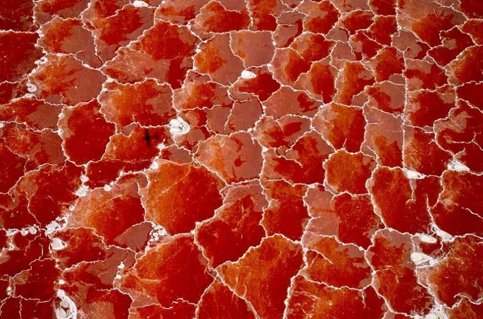
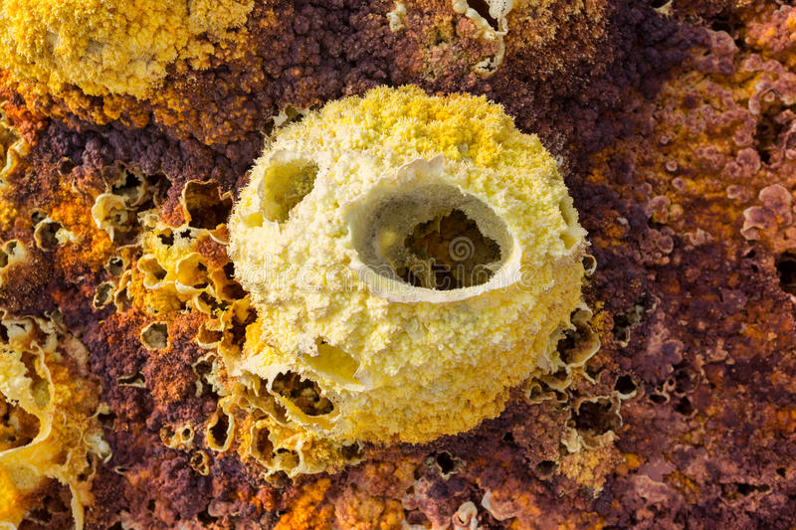
TOP 5
MOST DANGEROUS PLACES ON THE PLANET

Slide 3
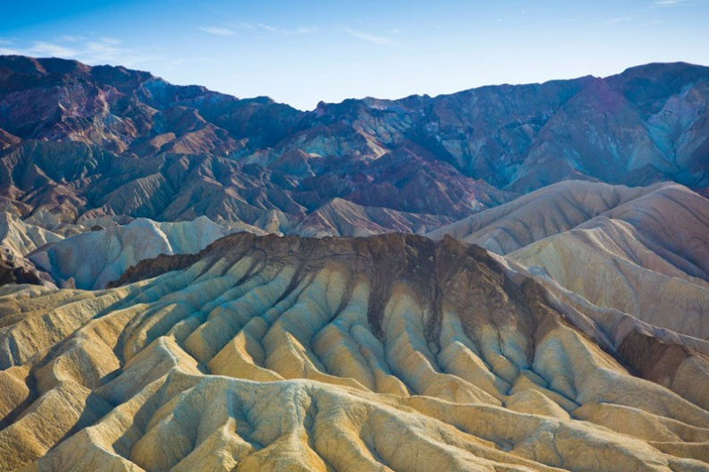
5. DEATH VALLEY

Slide 4


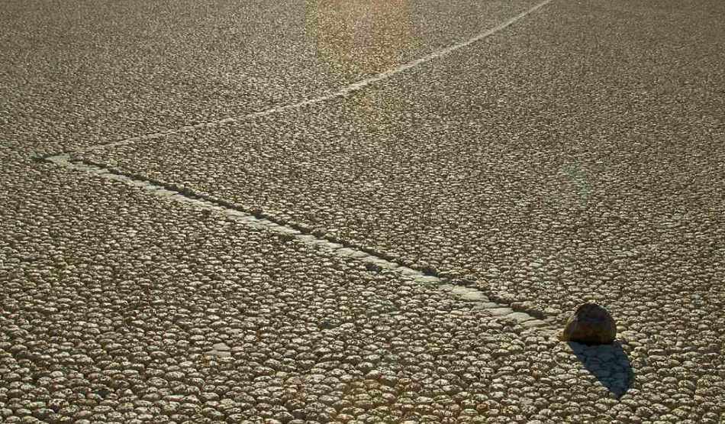
Location: Eastern California (SUA)
It is one of the hottest places in the world at the height of summertime along with deserts in Africa and in the Middle East.
This valley is also renowned for "traveling" stones.

Slide 5
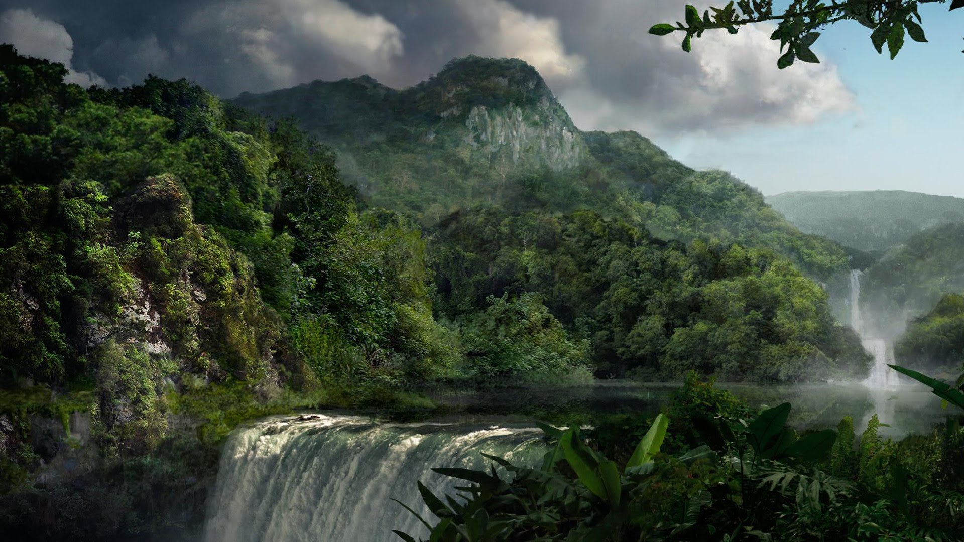
4. Madidi National Park

Slide 6
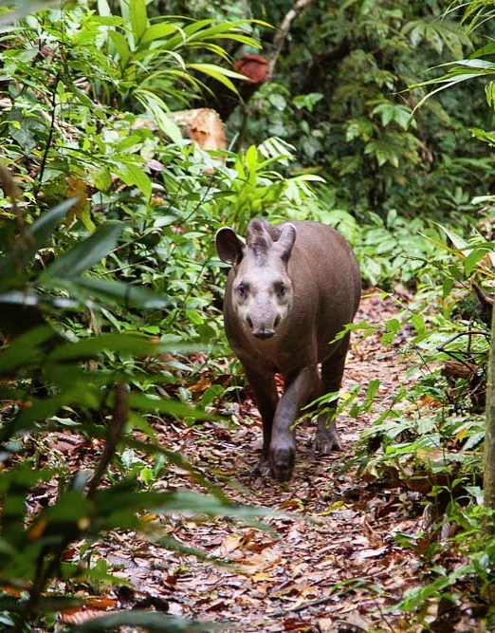
Location: Bolivia
The animals that are living in the park are of all sizes, from 300 kilograms to tapir to small insects not weighing more than 4 grams. A record number of leopards passes through the park of 19,000 square kilometers.

Slide 7
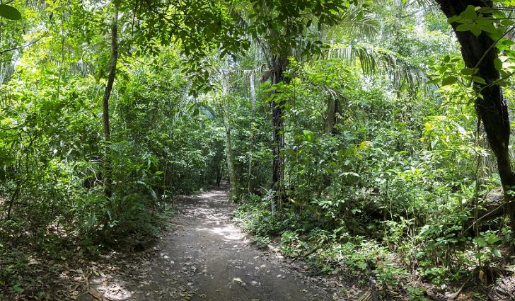
Why is this a dangerous place?

Slide 8
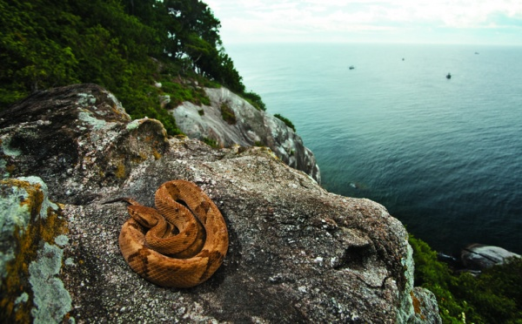
3. Snakes Island

Slide 9

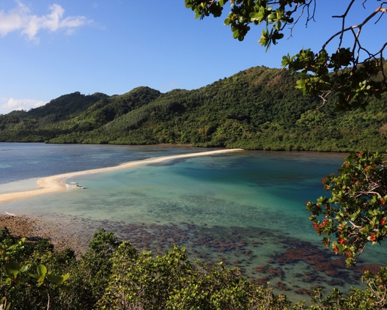
Details
Name: Ilha da Queimada Grande
Location: Brazilia
Inhabitants: between 2.000-4.000 snakes...

Slide 10
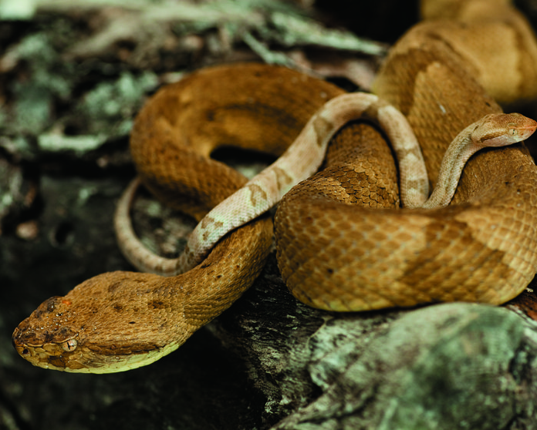
The “treasure” of the island
Golden lancehead vipera
Color of his skin: brownish brown, overlaid with triangular or romboidal patterns
Venom of these vipers is so powerful that the bite man dies in less than an hour

Slide 11
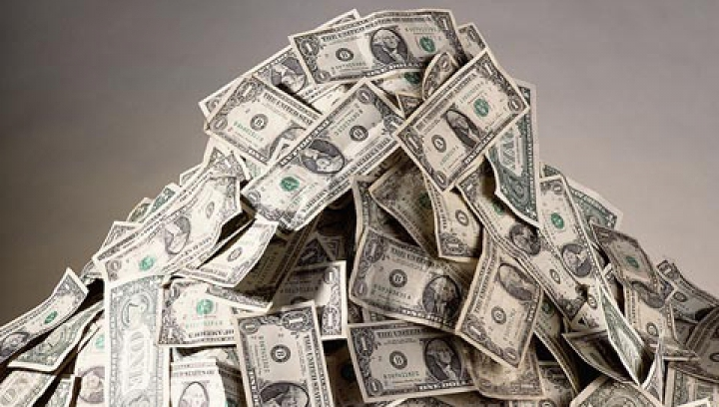
The motivation is special for poor people in Brazil, for a single viper is paid on the spot between 10.000-30.000 $.

Slide 12
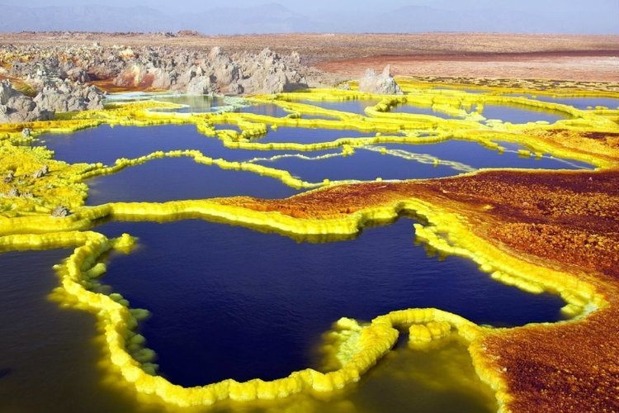
2. DALLOL

Slide 13
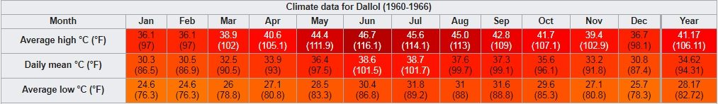
Location: Ethiopia’s Danakil Depression
Dallol currently holds the official record for high average temperature for an inhabited location on Earth, where an average annual temperature of 35°C (95°F) was recorded between the years 1960 and 1966.

Slide 14
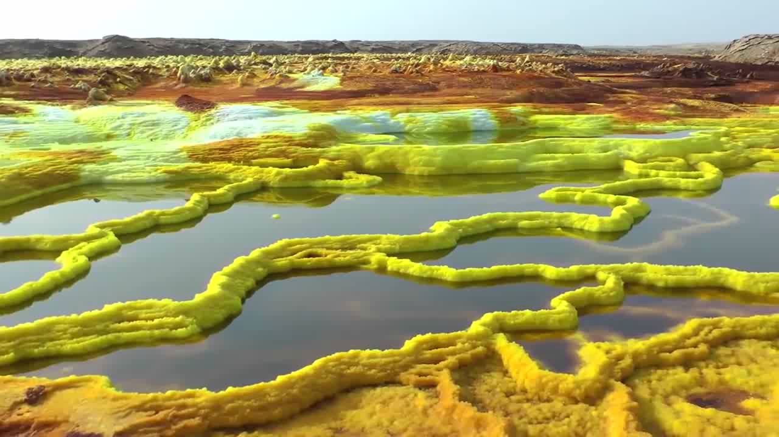

Slide 15

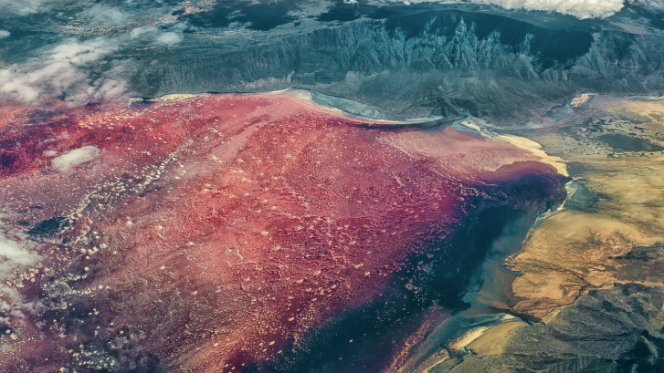
5. Lake natron
1. LAKE NATRON

Slide 16

DETAILS
Location: the border between Kenya and Tanzania
Component: natural mixture of substances called natron
Other name: Natronmeer

Slide 17
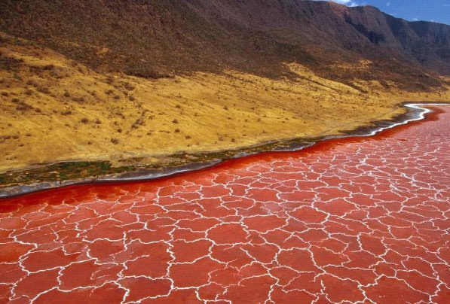
Attractions
1. Red colour
The cyanobacteria that occur in Lake Natron have a red pigment, which is why the water and the salt crust on the surface of the lake often turn deep orange to red.

Slide 18
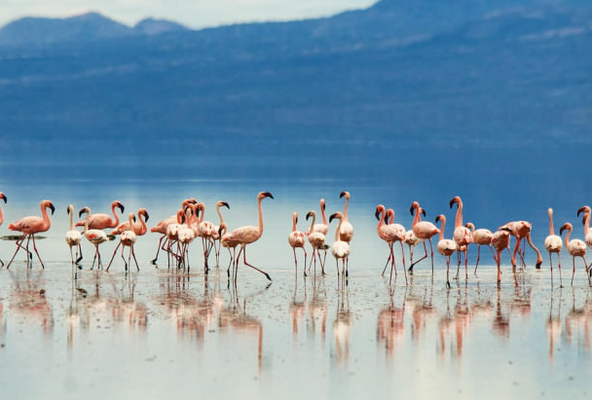
2. Flamingos
Natron is the habitat of over 2 million small flamingos. The capricious environment deters predators, allowing the flamingos to breed safely here.

Slide 19
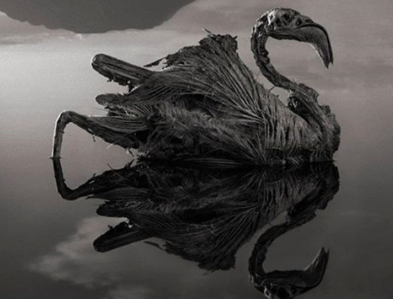
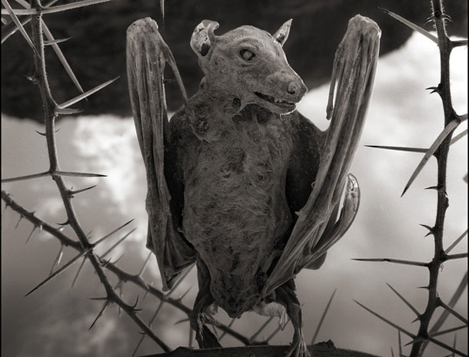
THE “POWER” OF WATER
Kill and turn into "stone stalls", the birds touching the surface of their waters, preserving them in almost perfect form.

Slide 20
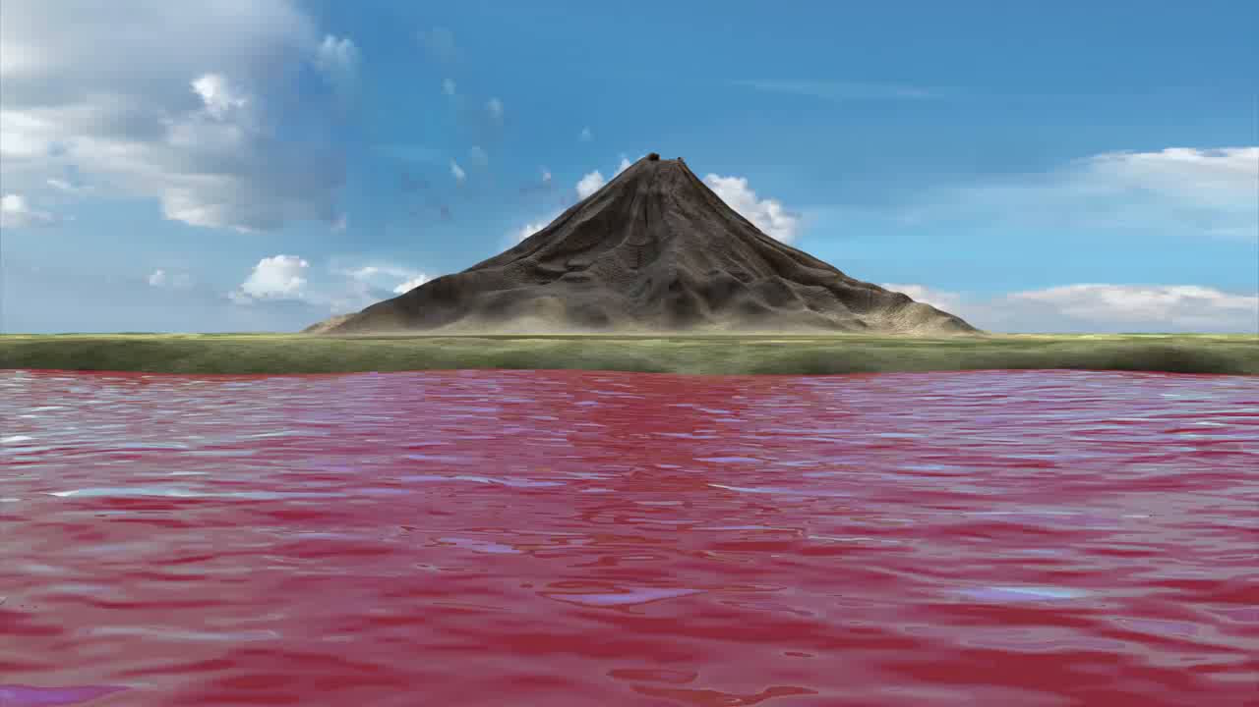

Slide 21
Bibliography
https://ro.wikipedia.org/wiki/Valea_Mor%C8%9Bii
http://www.ziare.com/magazin/specie/cel-mai-divers-loc-de-pe-terra-din-punct-de-vedere-al-speciilor-1189966
http://www.letsgo.ro/oras/parcul-national-madidi-3056/
http://travel.descopera.ro/13214849-Ilha-da-Queimada-Grande-cea-mai-periculoasa-insula-din-lume
https://ro.wikipedia.org/wiki/Dallol,_Etiopia
https://ro.wikipedia.org/wiki/Lacul_Natron
http://www.cunoastelumea.ro/lacul-natron-din-tanzania-locul-care-poate-transforma-vietuitoarele-in-pietre-ce-proprietati-are-apa-de-aici/

Slide 22
Top 5 strange mysteries that remain unsolved

Slide 23
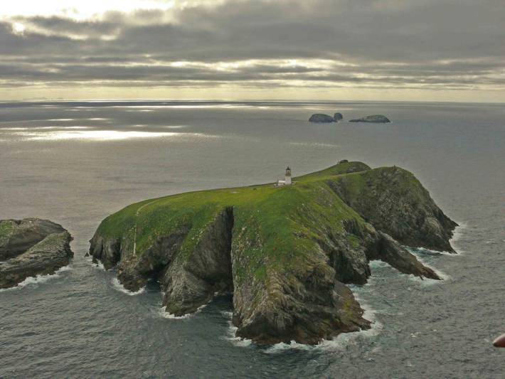
The Eilean Mor Lighthouse Mystery
The disappearance of three lighthouse keepers in 1900:
The day after Christmas, a supply ship arrived at the island, but the lighthouse keepers were not waiting for them.
A replacement lighthouse keeper, Joseph Moore, was sent to investigate.
The lighthouse door was unlocked, the clock in the kitchen had stopped working and he found the remains of a meal, but the lighthouse keepers were nowhere to be seen.

Slide 24
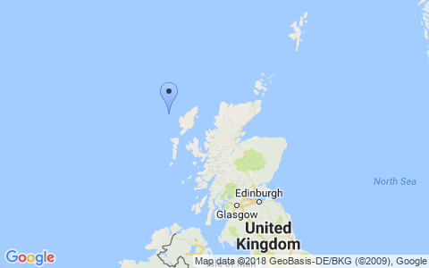
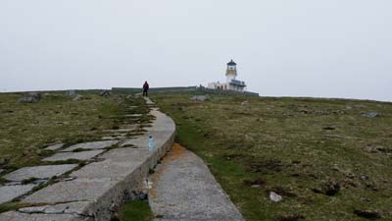
Thomas Marshall claimed that the island had been struck by severe winds, worse than anything he had experienced in his career, even though the lighthouse was solid enough to outlast any storm.
“Storm ended, sea calm. God is over all.”
Even though the lighthouse was visible from the nearby island, no storms were reported in the Eilean Mor area during the days noted in the log entry.
Theories about their disappearance have ranged from foreign invaders capturing the men, all the way through to alien abductions.

Slide 25
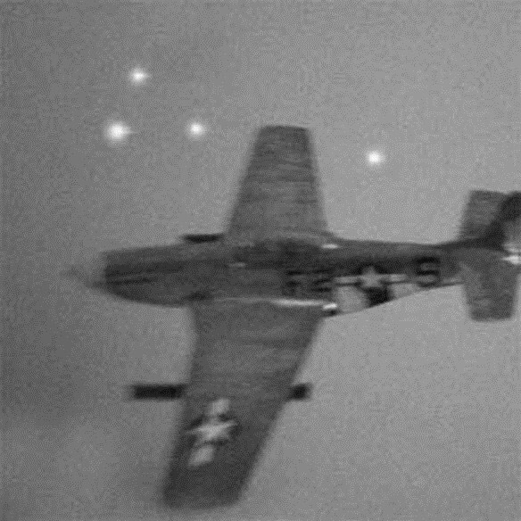
Foo Fighters
The term “foo fighters” was applied to various UFO sightings that occurred during the Second World War.
A Royal Air Force pilot was flying a fighter plane over France when he noticed two strange-looking lights following him, repeating all the moves he made.
Marines in the Solomon Islands reported seeing a formation of over 150 silver-colored objects racing through the sky.
New York Times officially described these "balls of fire“ as a "new German weapon“.

Slide 26
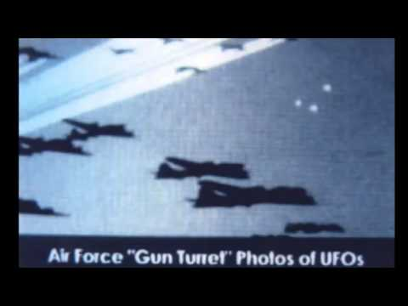
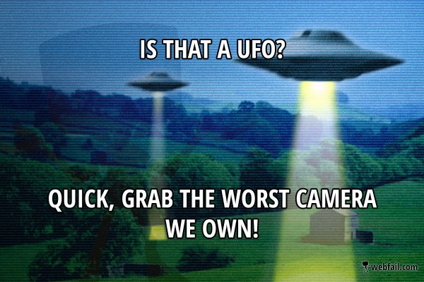
Some theories said that they were electrostatic or electromagnetic phenomena, or simply reflections of light from ice crystals.

Slide 27
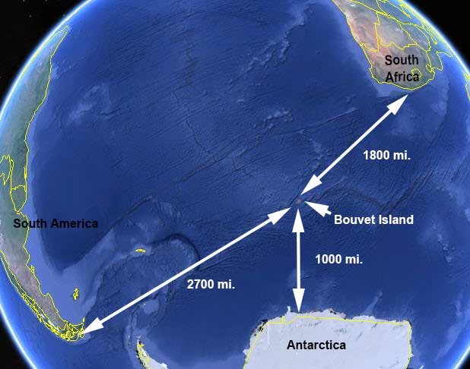
The Bouvet Island Lifeboat
Lying deep in the South Atlantic, Bouvet Island has been described as among the most isolated places on Earth.
Nobody has ever inhabited the island, since plant life is unsustainable there.
When a British expedition arrived, they discovered an abandoned lifeboat in a lagoon on the island.
Not far from the boat were oars, wood, a drum, and a copper tank. The boat was in a good condition, but they couldn’t find any trace of passengers.

Slide 28
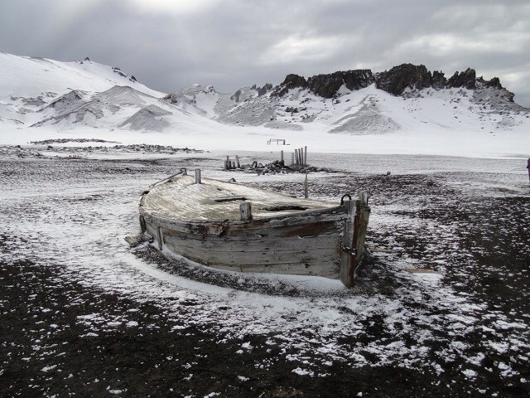
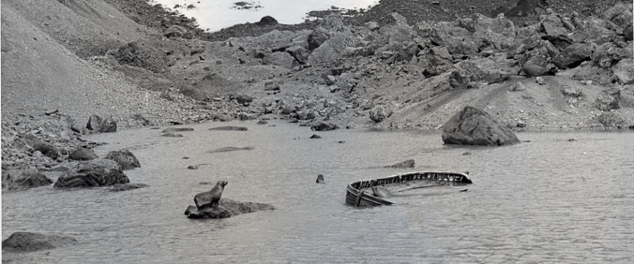
Even more strangely, when another expedition was sent to Bouvet Island two years later, the lifeboat had vanished. All of the other objects found near it had also disappeared.

Slide 29
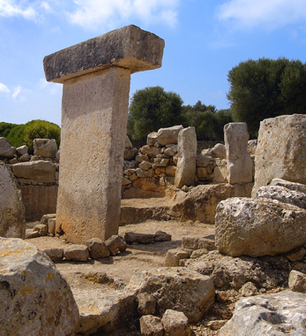
The Taulas Of Menorca
The taulas are ancient megaliths that stand on the Spanish island of Menorca, similar in appearance to the more famous Stonehenge.
There is no concrete evidence as to why the structures were built or why they are found only on Menorca and not on neighboring islands.

Slide 30
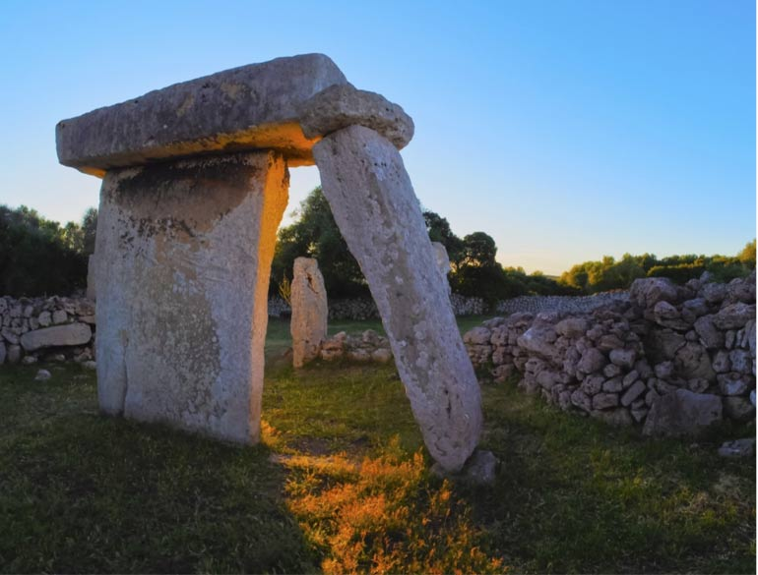
Some believe that the stones symbolized a temple of some sort.
Waldemar Fenn, a German archaeologist, has pointed out that the taulas all faced south, leading him to speculate that they were built as a religious monument to measure the movement of the moon.
Unfortunately, Fenn’s theory could only be applied to 12 of the 13 intact taulas.

Slide 31
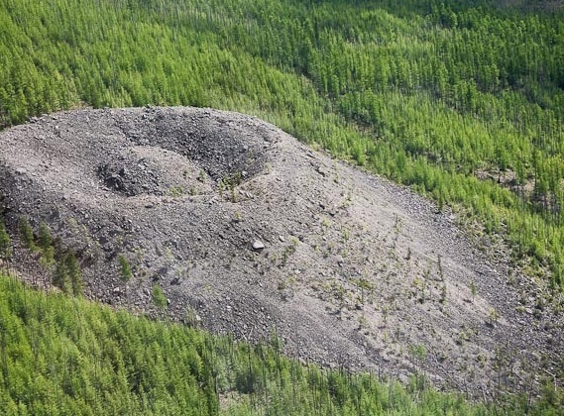
The Patomskiy Crater
Geologist Vadim Kolpakov set off on an expedition to Siberia.
As he traveled deep into some unexplored territory, the local Yakut people warned him not to go on, explaining that there was an evil place deep in the woods that even the animals avoided.
They called it the “Fire Eagle Nest” and claimed that people would start to feel unwell near it - and some would simply disappear without a trace.

Slide 32
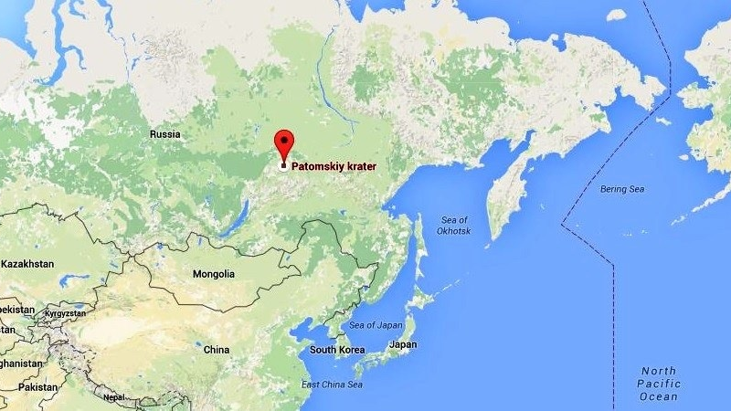
It resembled a volcano mouth, but Kolpakov knew that there had been no volcanoes in the area for at least a few million years. This crater looked relatively newly formed - around 250 years old.
The trees around it seemed to have undergone a period of accelerated growth, similar to that seen in the forests around Chernobyl.
Many even think that there is a UFO hidden underneath the crater.
In 2005, an expedition was launched in the hopes of finding some answers, but the leader of the expedition died of a heart attack just a few kilometers away from the site. The locals were convinced it was the “evil” crater that led to his death.

Slide 33
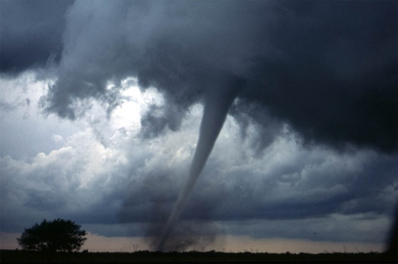
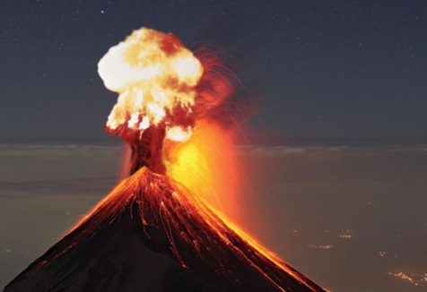
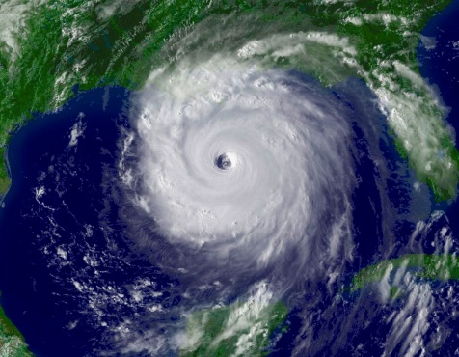
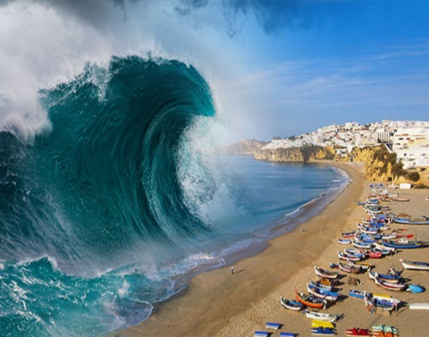
Top 5
Most Dangerous
Natural Disasters
1. Tornadoes
2. Earthquakes
3. Volcanic Eruptions
4. Tsunamis
5. Hurricane

Slide 34
Tornadoes
Also known as Twisters, Funnel Cloud or Waterspout.
Rotating, funnel-shaped clouds from powerful thunderstorms.
Winds up to 300 MPH capable of producing major damage.
More occur in the United States than anywhere else in the world.
They occur in every state in America.

Slide 35
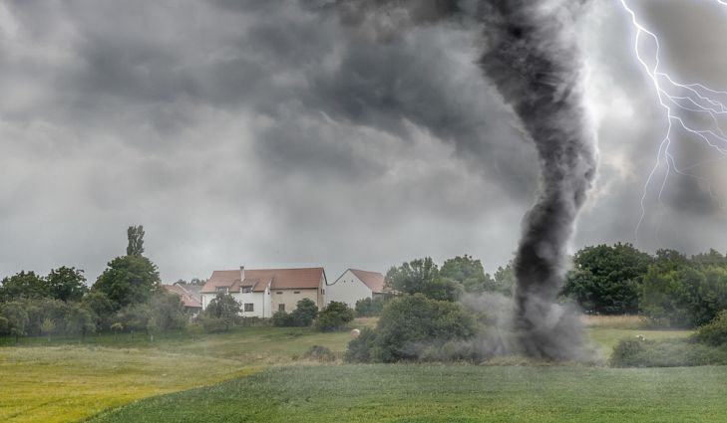
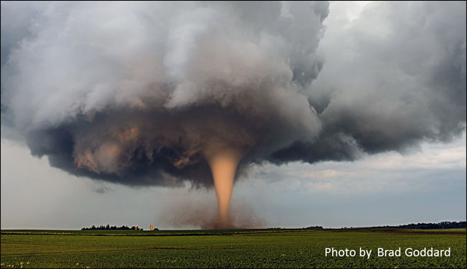
Tornadoes

Slide 36
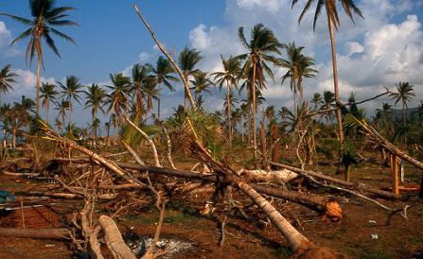
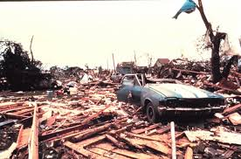
Tornadoes-effects
The biggest tornado recorded was the Hallam, Nebraska tornado on May 22, 2004. It was around 2.5 miles big and had a death toll of around 160.
The deadliest tornado recorded occurred in Daultipur and Salturia, Bangladesh on April 26th, 1989. 1300 recorded dead and 12,000 injured.

Slide 37
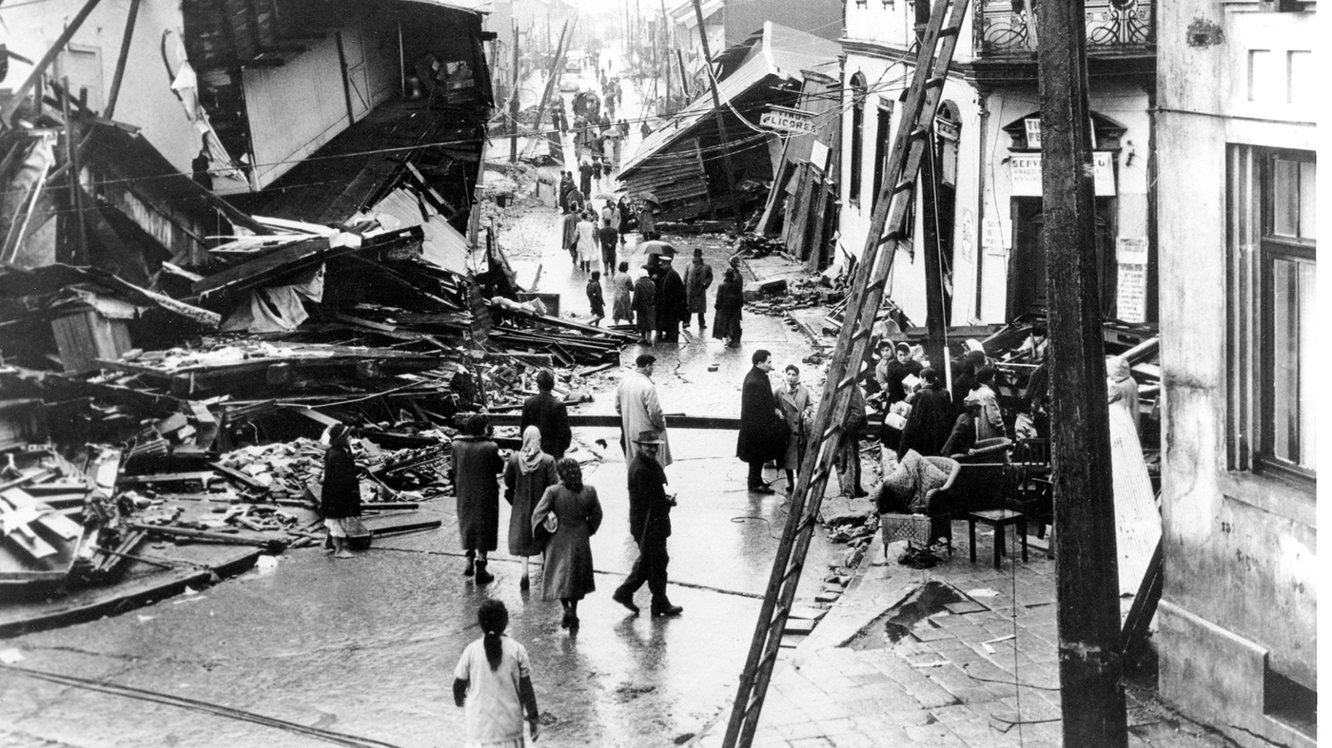
Earthquakes
Shaking caused by the movements of plates in the earth’s crust.
Occur along faults – borders between two plates.
They are measured using seismographs.
The Valdivia earthquake was the biggest earthquake ever recorded. It hit Chile on May 22, 1960 with a magnitude of 9.5 and a death toll of around 6000.

Slide 38
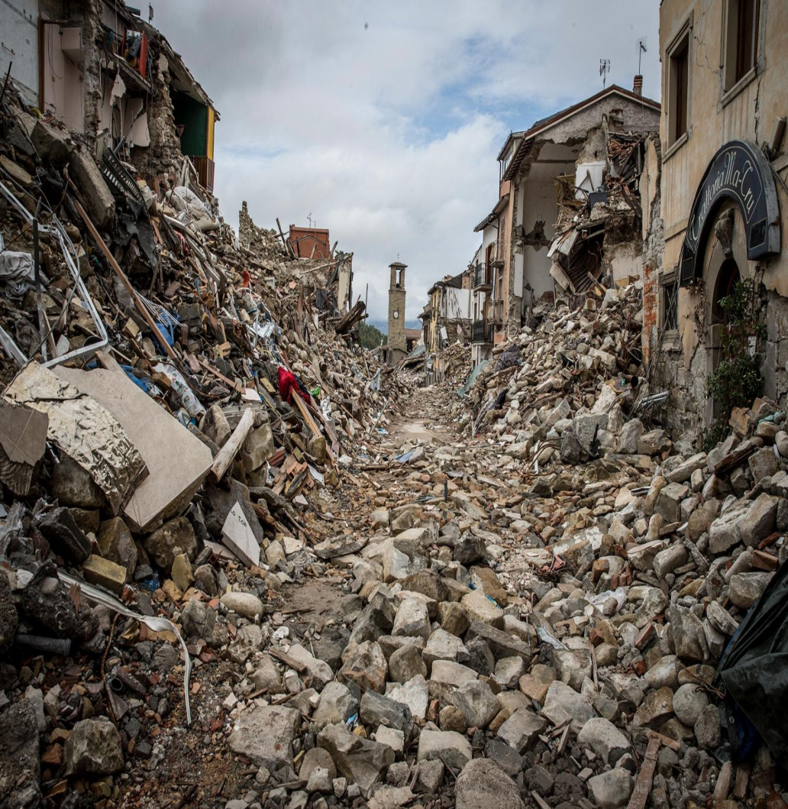
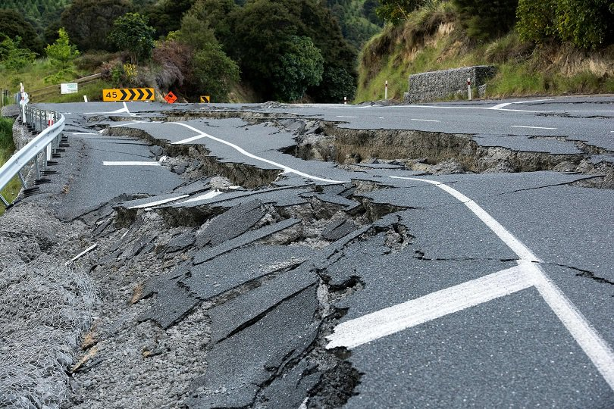
Earthquakes-Effects

Slide 39
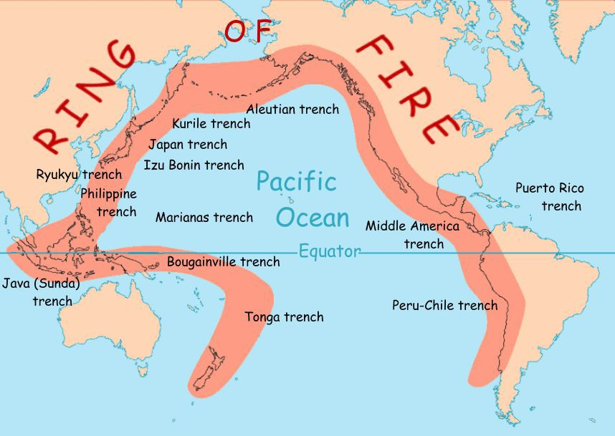
Volcanic Eruptions
A volcano is an opening in a planet’s surface which allows hot magma to escape from below to surface.
More than 500 active volcanoes in the world; over half in the Ring of Fire.
Pressure builds below the earth’s surface producing eruptions of lava, rock, and volcanic gases.

Slide 40
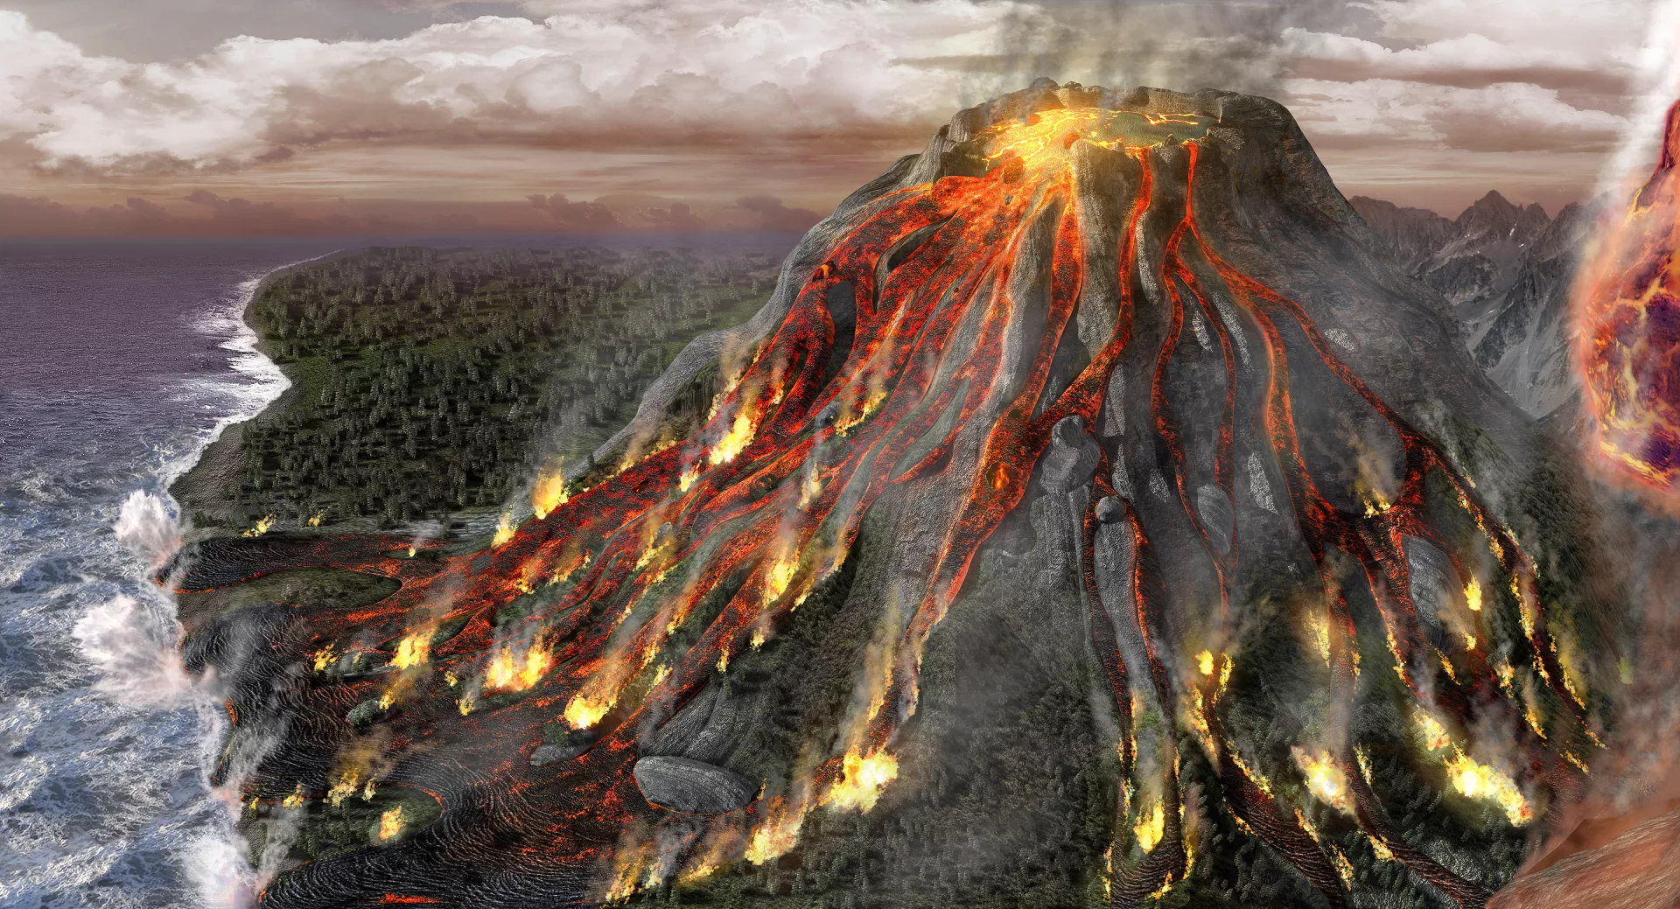
Volcanic Eruptions

Slide 41
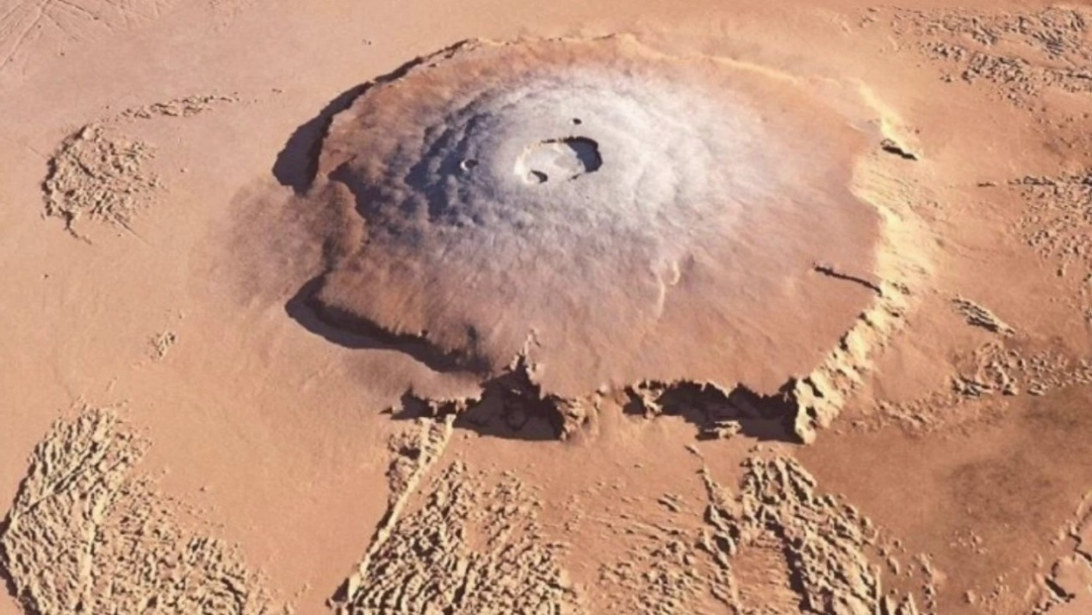
Volcanic Eruptions-Effects
The biggest volcanic eruption was Mount Tambora on 1815, It heard over 200 km away and had a death toll of around 71,000.
The largest volcano known to humans is Olympus Mons on Mars. It is even bigger than Mount Everest.

Slide 42
Tsunamis
Form as a result of earthquakes, volcanoes, or landsides under the ocean.
Waves grow taller as they reach the coast
Over 200,000 people killed in the 25th of December 2004 Indian Ocean tsunami. It is considered the 6th deadliest natural disaster.
The biggest tsunami ever happened was at Lituya Bay, Alaska in 1958 and it was around 150 meters tall.

Slide 43


Tsunamis

Slide 44


Hurricanes
Also known as Cyclones.
Massive severe storms occurring in the tropics.
Winds greater than 75 MPH.
Clouds & winds spin around the eye.
Produce heavy rains, high winds, large waves, and spin-off tornadoes.

Slide 45

Hurricanes

Slide 46

Hurricanes-Effects
The biggest hurricane was the Bhola hurricane. It hit the coast of today’s Bangladesh in 1970 with a death toll of around 500,000.

Slide 47





Top 5 Most Nostalgic TV Cartoons Of My Childhood
The Kids from Room 402
Life with Louie
What's with Andy?
Shaman King
X-Men

Slide 48

The Kids from Room 402
Canadian-American animated series
Betty Paraskevas & Michael Paraskevas
Comedy
2 seasons
Fox Family Channel
Group of elementary school students
Their teacher (Miss Graves)

Slide 49


Jesse (Jessie)
main character of the series
not the smartest kid in the school
baby’s mother
Nancy Francis
- main protagonist
helps Jesse
bossy

Slide 50

Life with Louie
American animated series
Louie Anderson & Matthew O'Callaghan
Comedy
3 seasons
Childhood of stand-up comedian Louie Anderson

Slide 51


Louis "Louie" Anderson
main character
eight-year-old child
very sensitive
intelligent
"Alright!"
Andrew "Andy" Mortimer Anderson
- difficult
- caring father
- veteran of World War II
- comic superiority complex and equally comical

Slide 52

What's with Andy?
Canadian animated series
Noam Kaniel, Alain Garcia (season 2) & Anthony Rozankovic (season 3)
Comedy
3 seasons
“World's greatest prankster“

Slide 53


Slide 54


Andrew "Andy" Larkin
- loves to prank people
13-year-old
loses his pants usually
interested in a certain girl
Daniel "Danny" Tadeus Pickett
- the best friend and Andy's right-hand man

Slide 55

Shaman King
Japanese manga series
Seiji Mizushima
Action-adventure, fantasy
1 season
Adventures of a 13-year-old shaman and his teammate a samurai warrior spirit

Slide 56


Yoh Asakura
- the main protagonist
ability to see ghosts
motivated by a promise
Hao Asakura
the main antagonist
- the second reincarnation of his original self
- the founder of the Asakura family

Slide 57

X-Men
American animated television series
Eric Lewald, Sidney Iwanter & Mark Edens
Superhero fiction, action/adventure
5 seasons
Mutant superheroes
Fight for justice

Slide 58


Storm
orphaned at an early age
claustrophobic
- controlling weather of all
Professor X
- the founder of the X-Men
- a lonely man
- possesses supremely powerful telepathic abilities

